Slide 1




YOUR TRUSTED HEALTHCARE SYSTEM.
HEALTHCARE MONITORING SYSTEM
TEAM MEMBERS:
Meher Fatima
Maria Malhotra
Tran Le

Slide 2
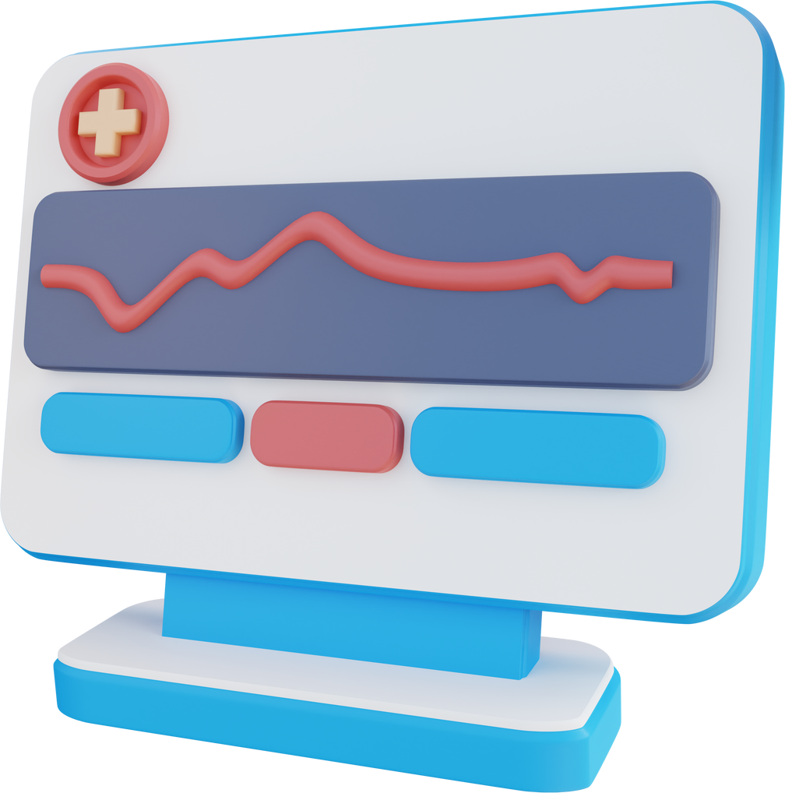
BUSINESS PROBLEM:
Scale: Chronic diseases affect an estimated 129 million Americans.
Impact: Chronic diseases are treatable and preventable, and yet Heart Disease, Diabetes & Kidney Disease are in the top 10 causes of death in the US.
Goal: Use patient records, prescriptions, and sensor data to prevent deaths, reduce complications, and promote self-management.

Slide 3
BUSINESS QUESTIONS
Most common chronic conditions?
2. Efficiency of monitoring system?
3. Patients with Type 2 Diabetes: who are at high-risk?
4. Most effective therapies for Type 2 Diabetes?

Slide 4

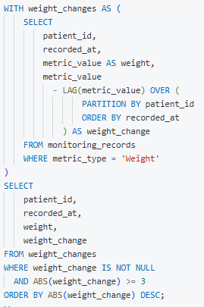
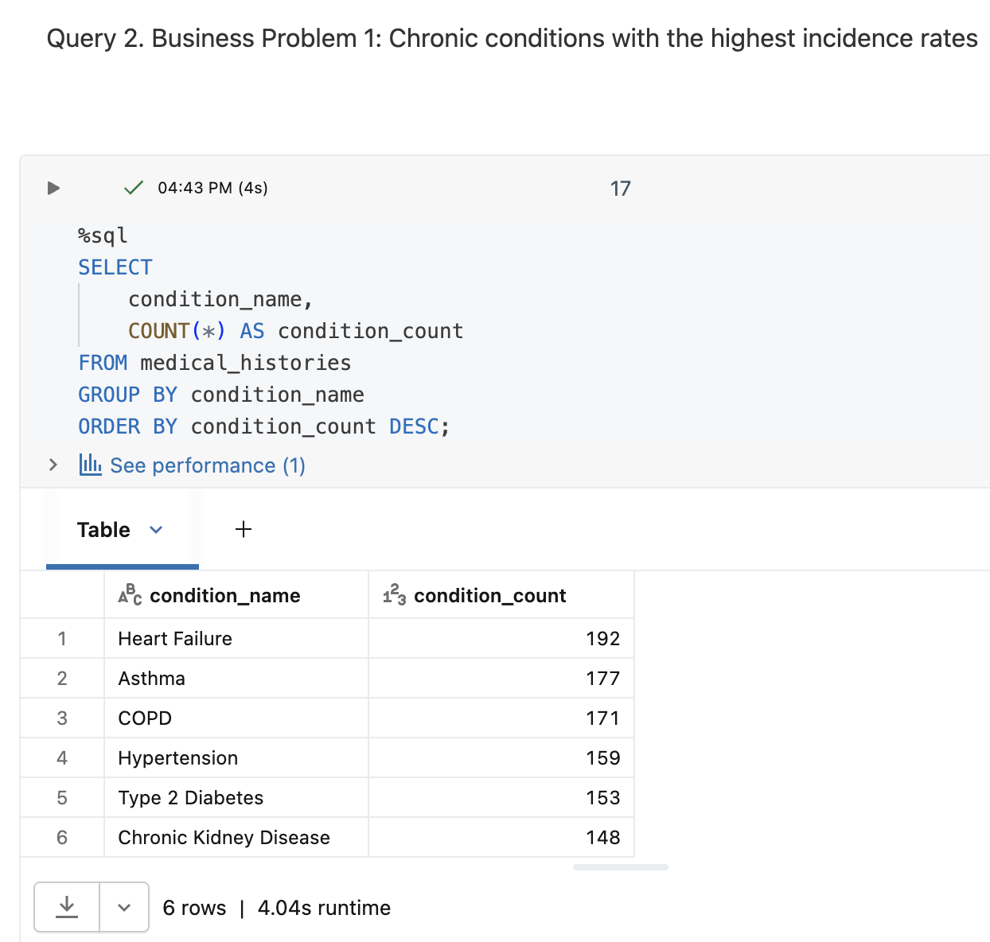
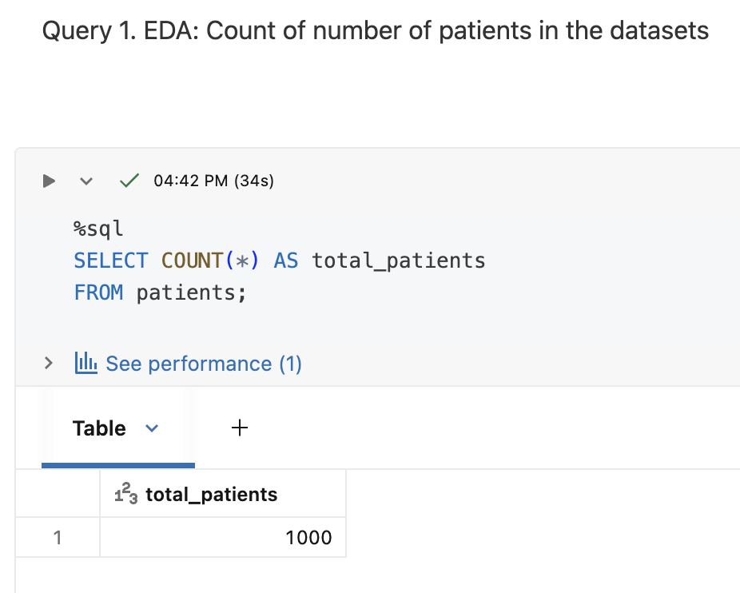
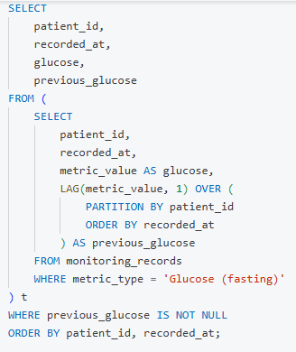
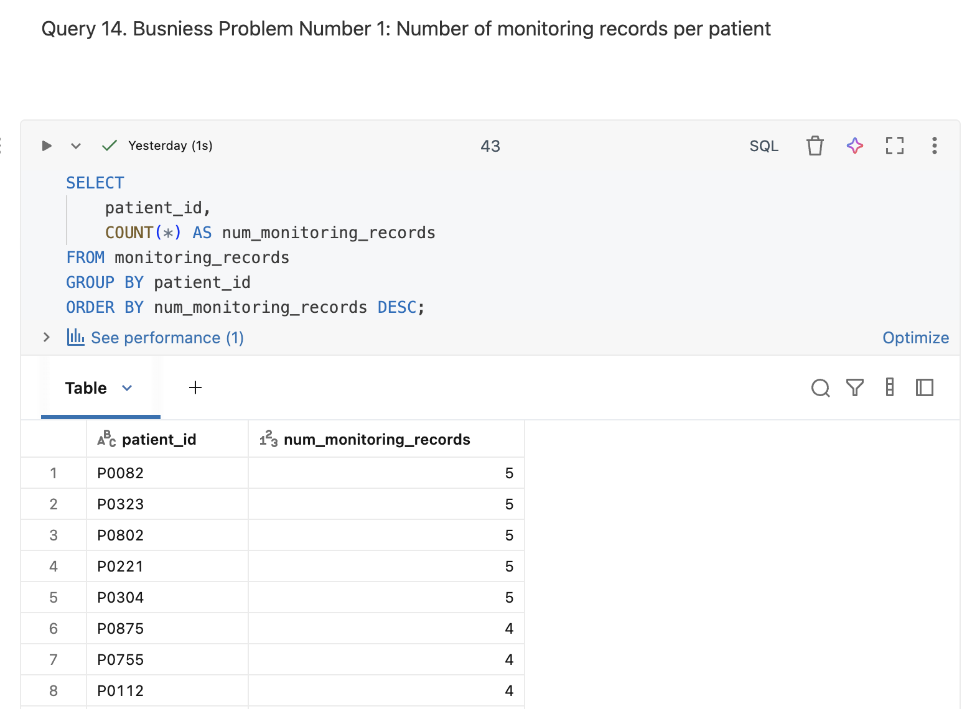
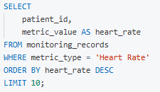
ACTIONABLE INTELLIGENCE: THE CHRONIC DISEASE DASHBOARD

Slide 5

YOUR SAFETY MATTERS TO US.

Slide 6


THANK YOU!

